Slide 1
Oracle SQL Tuning & Optimizer ( Part 1) – SQL Base Knowledge
Luke (Zhaoping.lu@oracle.com)
PSFT P&B, 2016.09

Slide 2
About
The target audience of this training is the PSFT developers/QA/… who have the basic SQL knowledge.
This training intend to introduce the tuning and related knowledge about Oracle SQL itself. Will not focus on DBA related SQL tuning knowledge, for example, Sql Baseline Management, unless it could be helpful for developers/QA/…’ routine work.
Please feel free to interrupt me if you have questions.

Slide 3
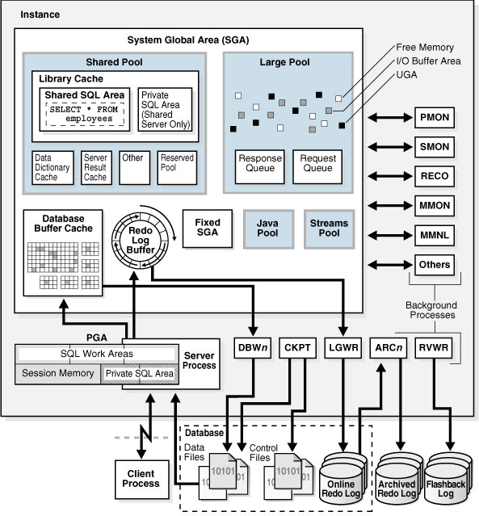
Oracle Database Architecture
Database
Data Files
Control Files
Redo Files
Instance
PGA
SQL Work Area
Private SQL Area
SGA
Shared Pool
Library Cache

Slide 4
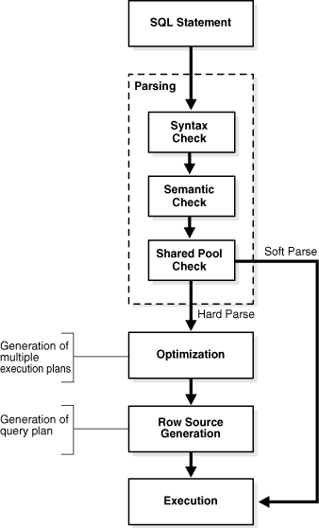
Overview of SQL Processing
Parsing
Tip: Use bind variable to avoid hard parse
Optimization
Query Transformation
Estimation
Generating Execution Plan
Execution
Notes:
Ref: http://docs.oracle.com/database/121/TGSQL/tgsql_sqlproc.htm#TGSQL176

Slide 5
Tip: Use bind variable to avoid hard parse
OLTP:
Use bind variables, avoid literal SQL, avoid hard parse.
Test Case:
OLAP: It depends: Sometimes, Literal SQL is a better choice.
--Hard Parse: Declare ret number; Begin for i in 1 .. 100000 loop execute immediate 'select 1 from dual where rownum<='|| i into ret; end loop; End; / | --Soft Parse: Declare ret number; Begin for i in 1 .. 100000 loop execute immediate 'select 1 from dual where rownum<= :x' into ret using i; end loop; End; /
Notes:
Case 1: Query, Soft Parse vs. Hard Parse
--exec runstats.rs_start
--Hard Parse:
declare
ret number;
begin
for i in 1 .. 10000
loop
execute immediate 'select 1 from dual where rownum<='||i into ret;
end loop;
end;
/
--exec runstats.rs_middle
--Soft Parse:
declare
ret number;
begin
for i in 1 .. 100000
loop
--select 1 into ret from dual where rownum<=i; --17s
execute immediate 'select 1 from dual where rownum<= :x' into ret using i; --20s
end loop;
end;
/
--exec runstats.rs_stop
Case 2: DML, Soft Parse vs. Hard Parse
PreReq:
drop table test;
create table test (id number);
drop table test_gtt;
create global temporary table test_gtt(id number) on commit preserve rows;
Hard Parse:
declare
ret number;
begin
for i in 1 .. 1000000
loop
execute immediate 'insert into test values('||i||')';
end loop;
commit;
end;
/
Soft Parse:
declare
ret number;
begin
for i in 1 .. 1000000
loop
insert into test values(i);
commit;
end loop;
end;
/

Slide 6
Soft Parse vs. Hard Parse
30X
Soft Parse is 30X faster than Hard Parse in this case
Hard Parse: 1.7k/s
Soft Parse: 52.8k/s
Test Env.: Exadata X2, DB12.1
Notes:
Case 1
--exec runstats.rs_start
--Hard Parse:
declare
ret number;
begin
for i in 1 .. 10000
loop
execute immediate 'select 1 from dual where rownum<='||i into ret;
end loop;
end;
/
--exec runstats.rs_middle
--Soft Parse:
declare
ret number;
begin
for i in 1 .. 100000
loop
--select 1 into ret from dual where rownum<=i; --17s
execute immediate 'select 1 from dual where rownum<= :x' into ret using i; --20s
end loop;
end;
/
--exec runstats.rs_stop
Case 2:
PreReq:
drop table test;
create table test (id number);
drop table test_gtt;
create global temporary table test_gtt(id number) on commit preserve rows;
Hard Parse:
declare
ret number;
begin
for i in 1 .. 1000000
loop
execute immediate 'insert into test values('||i||')';
end loop;
commit;
end;
/
Soft Parse:
declare
ret number;
begin
for i in 1 .. 1000000
loop
insert into test values(i);
commit;
end loop;
end;
/

Slide 7
SQL Parsing
Parsing
Syntax Check
Semantic Check
Shared Pool Check
Hard/Soft Parse
Notes:
Ref: http://docs.oracle.com/database/121/TGSQL/tgsql_sqlproc.htm#TGSQL176

Slide 8
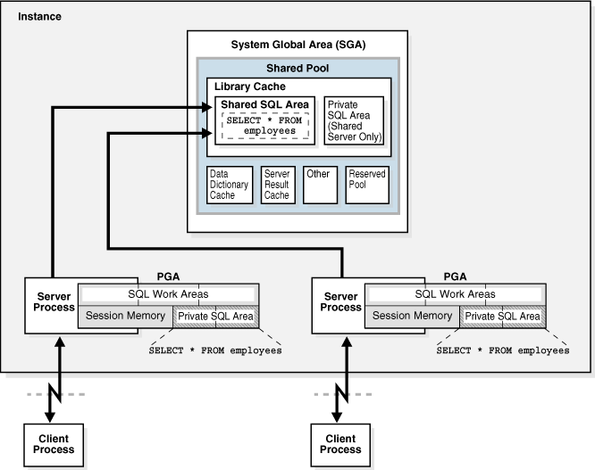
Where does Oracle Store Parsed SQL
In PGA
Private SQL Area
SQL Work Area (runtime)
In SGA (Shared Pool/Library Cache)
Shared SQL Area

Slide 9
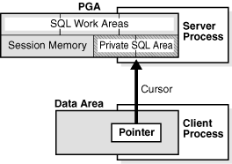
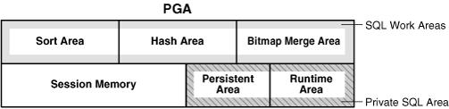
SQL In PGA
Private SQL Area
session-specific info for processing
Bind variable values
Stored in Persistent Area
query execution state information
Stored in Runtime Area
query execution work area
Stored in SQL Work Area
SQL Work Area
Sort Area for sort/aggregate/.. operations
Hash Area for hash join, ..
Notes:
About Cursors
A private SQL area holds information about a parsed SQL statement and other session-specific information for processing.
When a server process executes SQL or PL/SQL code, the process uses the private SQL area to store bind variable values, query execution state information, and query execution work areas.
The private SQL areas for each execution of a statement are not shared and may contain different values and data.
A cursor is a name or handle to a specific private SQL area. The cursor contains session-specific state information such as bind variable values and result sets.
Private and Shared SQL Areas
A cursor in the private SQL area points to a shared SQL area in the library cache. Unlike the private SQL area, which contains session state information, the shared SQL area contains the parse tree and execution plan for the statement.
For example, an execution of SELECT * FROM employees has a plan and parse tree stored in one shared SQL area. An execution of SELECT * FROM departments, which differs both syntactically and semantically, has a plan and parse tree stored in a separate shared SQL area.
MulTips le private SQL areas in the same or different sessions can reference a single shared SQL area, a phenomenon known as cursor sharing. For example, an execution of SELECT * FROM employees in one session and an execution of the SELECT * FROM employees (accessing the same table) in a different session can use the same parse tree and plan. A shared SQL area that is accessed by mulTips le statements is known as a shared cursor.
Private SQL Area memory arch:
https://docs.oracle.com/cd/E11882_01/server.112/e40540/memory.htm#CNCPT1237
A private SQL area is divided into the following areas:
The run-time area
This area contains query execution state information. For example, the run-time area tracks the number of rows retrieved so far in a full table scan.
Oracle Database creates the run-time area as the first step of an execute request. For DML statements, the run-time area is freed when the SQL statement is closed.
The persistent area
This area contains bind variable values. A bind variable value is supplied to a SQL statement at run time when the statement is executed. The persistent area is freed only when the cursor is closed.
SQL Work Areas
A work area is a private allocation of PGA memory used for memory-intensive operations. For example, a sort operator uses the sort area to sort a set of rows. Similarly, a hash join operator uses a hash area to build a hash table from its left input, whereas a bitmap merge uses the bitmap merge area to merge data retrieved from scans of mulTips le bitmap indexes.

Slide 10
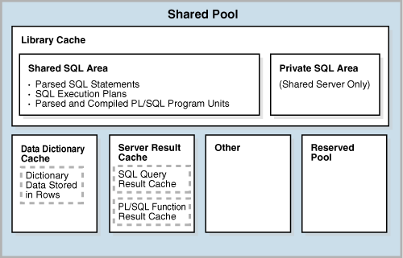
SQL in SGA
Shared SQL Area
In the Shared pool/Library Cache
Contains the parse tree and execution plan for a SQL statement.
Only one shared SQL area exists for a unique statement.
Notes:
execution plan
The combination of steps used by the database to execute a SQL statement. Each step either retrieves rows of data physically from the database or prepares them for the user issuing the statement. You can override execution plans by using hints.
parse tree (aka: execution tree)
A tree diagram that shows the flow of row sources from one step to another in an execution plan.
Parse Tree:
Ref: https://docs.oracle.com/cd/E11882_01/server.112/e40540/sqllangu.htm#CNCPT316
Figure 7-5 is an execution tree, also called a parse tree, that shows the flow of row sources from one step to another. In general, the order of the steps in execution is the reverse of the order in the plan, so you read the plan from the bottom up. Initial spaces in the Operation column indicate hierarchical relationships. For example, if the name of an operation is preceded by two spaces, then this operation is a child of an operation preceded by one space. Operations preceded by one space are children of the SELECT statement itself.

Slide 11
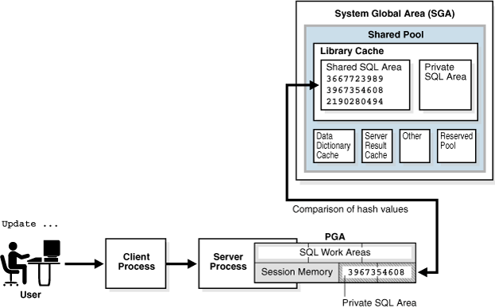
SQL Cursor - Shared Pool Check
The database uses a hashing algorithm to generate a hash value for every SQL statement.
V$SQL.SQL_ID.
If SQL cursor exists in the library cache by hash value.
If no matching hash value exists -> hard parse.
Even matched, could still cause hard parse.
Underlying objects belongs to different schema
The session environment.
Adaptive Cursor Sharing
Notes:
sql id -> hash value:
take the SQL ID, interpret it as a 13 character base-32 encoded number and then take only the lowest 4 bytes worth of information (4 bytes in base-256) out of that number and that’s the hash value.
select lower(trim('&1')) sql_id , trunc(mod(sum((instr('0123456789abcdfghjkmnpqrstuvwxyz',substr(lower(trim('&1')),level,1))-1) *power(32,length(trim('&1'))-level)),power(2,32))) hash_value from dual connect by level <= length(trim('&1'));
Ref: http://blog.tanelpoder.com/2009/02/22/sql_id-is-just-a-fancy-representation-of-hash-value/
Dbms_utility.get_sql_hash
This function computes a hash value for the given string using MD5 algorithm.
A hash value (last 4 bytes) based on the input string. the MD5 hash algorithm computes a 16 byte hash value, but we only return the last 4 bytes so that we can return an actual number. one could use an optional raw parameter to get all 16 bytes and to store the pre 10i hash value of 4 bytes in the pre10i hash optional parameter.
Ref: http://docs.oracle.com/database/121/ARPLS/d_util.htm#ARPLS73253

Slide 12
Hard Parse & Soft Parse
Hard parse
If Oracle Database cannot reuse existing code, then it must build a new executable version of the application code. This operation is known as a hard parse, or a library cache miss.
In Short: Build a new execution plan.
Soft parse
A soft parse is any parse that is not a hard parse. If the submitted statement is the same as a reusable SQL statement in the shared pool, then Oracle Database reuses the existing code. This reuse of code is also called a library cache hit.
Skips the optimization and row source generation steps, proceeding straight to execution.
Soft parses can vary in how much work they perform. For example, configuring the session shared SQL area can sometimes reduce the amount of latching in the soft parses, making them "softer.“
In Short: Reuse the existing execution plan.

Slide 13
Other cases could cause hard parse
Underlying objects belongs to different schema
A.table_name1 and B.table_name1
In Schema A: select * from table_name1;
In Schema B: select * from table_name1;
The session environment.
alter session set optimizer_index_cost_adj=…;

Slide 14
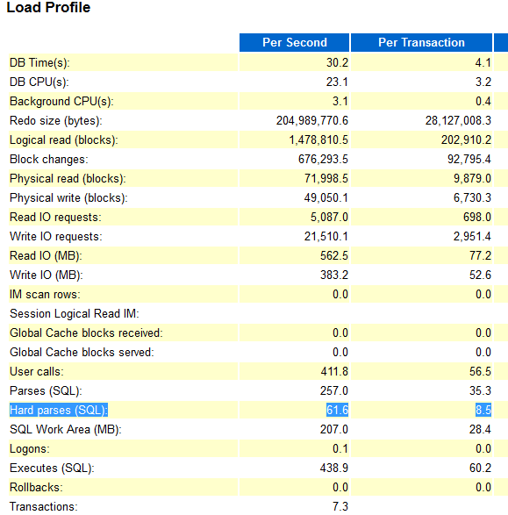
How to identify hard parse SQL in AWR report
Load Profile Section
Hard Parses (SQL)
Top Events Section
latch: shared pool
library cache: mutex X
Top SQL Section
AWR usually will not be able to capture
the hard parse SQL unless cursor_sharing<>EXACT
A workaround:
select FORCE_MATCHING_SIGNATURE,count(*),max(sql_id),min(sql_id) from v$sql group by FORCE_MATCHING_SIGNATURE order by 2 desc fetch first 10 rows only;

Slide 15
Overview of SQL Processing
Parsing
Optimization
Query Transformation
Estimation
Generating Execution Plan
Execution
Notes:
Ref: http://docs.oracle.com/database/121/TGSQL/tgsql_sqlproc.htm#TGSQL176

Slide 16
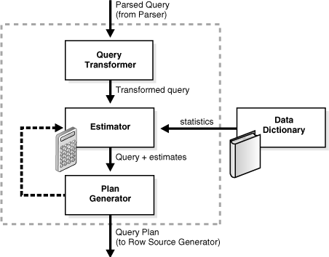
Optimizer Components – Query Transformer
Rewrite the original SQL statement into a semantically equivalent SQL statement with a lower cost
View Merging
Tip: Optimizer can do View Merging for you
Subquery Unnesting
Query Rewrite with Materizlized Views
Star Transformation
In-Memory Aggregation
…
Notes:
Ref: http://docs.oracle.com/database/121/TGSQL/tgsql_transform.htm#TGSQL94844

Slide 17
Query Transformer - View Merging - Case 1
Original SQL statement:
Transformed by Optimizer:
SELECT … FROM employees e, ( SELECT … FROM departments d, locations l WHERE d.xxx = l.xxx ) v WHERE e.yyy = v.yyy and …;
SELECT … FROM employees e, departments d, locations l WHERE d.xxx = l.xxx AND d. yyy = e.yyy AND …;
Notes:
Ref: http://docs.oracle.com/database/121/TGSQL/tgsql_optcncpt.htm#TGSQL204

Slide 18
Tip: Optimizer can do View Merging for you
So don’t afraid to write SQL with view if it makes your SQL easy to understand/read
View Merging may not happen if:
The view contains constructs not included in select-project-join views, including:
GROUP BY / DISTINCT / Outer join / MODEL / CONNECT BY / ROLLUP / PIVOT / Set operators / Aggregation
The view appears on the right side of a semijoin or antijoin.
The view contains subqueries in the SELECT list.
The outer query block contains PL/SQL functions.
The view participates in an outer join, and does not meet one of the several additional validity requirements that determine whether the view can be merged.
Control View Merging:
_simple_view_merging
_complex_view_merging

Slide 19
Query Transformer - View Merging – Case 2
Original SQL statement:
CREATE VIEW cust_prod_totals_v AS SELECT SUM(s.quantity_sold) total, s.cust_id, s.prod_id FROM sales s GROUP BY s.cust_id, s.prod_id; SELECT c.cust_id, c.cust_first_name, c.cust_last_name, c.cust_email FROM customers c, products p, cust_prod_totals_v WHERE c.country_id = 52790 AND c.cust_id = cust_prod_totals_v.cust_id AND cust_prod_totals_v.prod_id = p.prod_id AND p.prod_name = 'T3 Faux Fur-Trimmed Sweater‘ AND cust_prod_totals_v.total > 100;
Notes:
Ref: http://docs.oracle.com/database/121/TGSQL/tgsql_optcncpt.htm#TGSQL204

Slide 20
Query Transformer - View Merging – Case 2
Transformed by Optimizer:
SELECT c.cust_id, cust_first_name, cust_last_name, cust_email FROM customers c, products p, sales s WHERE c.country_id = 52790 AND c.cust_id = s.cust_id AND s.prod_id = p.prod_id AND p.prod_name = 'T3 Faux Fur-Trimmed Sweater' GROUP BY s.cust_id, s.prod_id, p.rowid, c.rowid, c.cust_email, c.cust_last_name, c.cust_first_name, c.cust_id HAVING SUM(s.quantity_sold) > 100;
Notes:
Ref: http://docs.oracle.com/database/121/TGSQL/tgsql_optcncpt.htm#TGSQL204

Slide 21
Optimizer Components – Query Transformer
Rewrite the original SQL statement into a semantically equivalent SQL statement with a lower cost
View Merging
Subquery Unnesting
Tip: Subquery unnesting disabled in PSFT DB
Tip: In and Exists Subquery are similar now
Query Rewrite with Materialized Views
Star Transformation
In-Memory Aggregation
…
Notes:
Ref: http://docs.oracle.com/database/121/TGSQL/tgsql_transform.htm#TGSQL94844

Slide 22
Query Transformer – Subquery Unnesting
A sub-query block that appears in the WHERE, SELECT and HAVING clauses.
Unnesting either merges the subquery into the body of the outer query or turns it into an inline view.
Without unnesting, the subquery is evaluated 1 time for each row of the outer table
Notes:
Any sub-query block in a query statement may be called a subquery; however, we use the term subquery for a sub-query block that appears in the WHERE, SELECT and HAVING clauses. Some Oracle documentation uses the term "nested subquery" for what we refer to as a subquery. A sub-query block that appears in the FROM clause is called a view or derived table.
Ref: https://blogs.oracle.com/optimizer/entry/optimizer_transformations_subquery_unesting_part_1
Validity of Unnesting
Every subquery, before it can be unnested, goes through a set of validity checks. The optimizer decisions to unnest or not to unnest a subquery can be overridden by specifying an appropriate hint, but the validity requirements cannot be, since unnesting in such cases would not guarantee a semantically equivalent query. In the following, we enumerate some important checks that currently invalidate subquery unnesting. Note that this list of checks is by no means exhaustive.
Subqueries that are correlated to non-parent; for example, subquery SQ3 is contained by SQ2 (parent of SQ3) and SQ2 in turn is contained by SQ1 and SQ3 is correlated to tables defined in SQ1.
A group-by subquery is correlated; in this case, unnesting implies doing join after group-by. Changing the given order of the two operations may not be always legal.
Connecting or correlating conditions are not well-formed (e.g., they contains a mix of local and correlated columns on either side of the predicate) and the subquery requires inline view generation, as predicates of this kind do not allow separating out view columns and outer table columns.
For disjunctive subqueries, the outer columns in the connecting or correlating conditions are not the same.
Using view-merging transformation, Oracle may merge the group-by or distinct inline view generated during unnesting, and therefore the execution plan may not show any view even when a view is expected.
Ref: https://blogs.oracle.com/optimizer/entry/optimizer_transformations_subquery_unesting_part_2

Slide 23
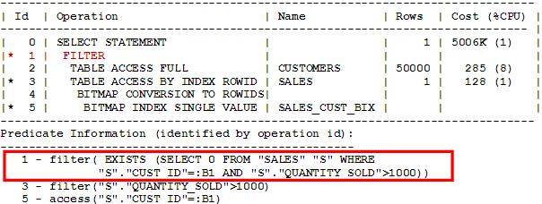
Query Transformer - Subquery Unnesting Sample
Without Subquery Unnesting:
SELECT C.cust_last_name, C.country_id FROM customers C WHERE EXISTS (
SELECT 1 FROM sales S WHERE S.quantity_sold > 1000 and S.cust_id = C.cust_id
);
The subquery will be evaluated 1 time for each outer row of CUSTOMERS table!

Slide 24
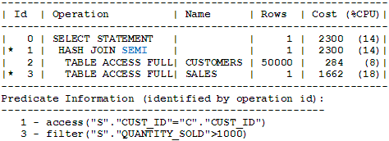
Query Transformer - Subquery Unnesting Sample (cont’d.)
With Subquery Unnesting:
SELECT C.cust_last_name, C.country_id FROM customers C, sales S WHERE S.quantity_sold > 1000 and C.cust_id S= S.cust_id;
Note: Presume each customer only have one row in sales table.
But …

Slide 25
Subquery Unnesting - Disabled in Peoplesoft DB
PeopleSoft makes extensive use of effective-dated and effective-sequenced rows and uses or generates SQL with correlated sub-queries to find the current effective-dated rows. i.e.
The problem is that the optimizer grossly underestimates the cardinality of the correlated sub-queries where there are multiple correlating columns leading it to choose SQL transformation where it has unnested the sub-query as an inline view.
SELECT * FROM PS_CURR_GRSTP_TBL G , PS_CURR_STEP_TBL S WHERE ... AND S.EFFDT = (SELECT MAX(X.EFFDT) FROM PS_CURR_STEP_TBL X WHERE ... AND X.EFFDT <= TO_DATE('2013-12-31','YYYY-MM-DD'));
Notes:
1. Disable Subquery Unnesting in peoplesoft application (_unnest_subquery=false)
2. Required Interim Patches for the Oracle Database with PeopleSoft (Doc ID 1100831.1)
Poor query performance with SQL statements utilizing nested subqueries
The default value for the initialization parameter _unnest_subquery is TRUE. PeopleTools requires it to be set to FALSE by default. During internal testing with the default value in place, performance issues occurred in on-line processing. There were also some occasional errors creating views. This is due to the following optimizer behavior: “PeopleSoft makes extensive use effective-dated and effective-sequenced rows and uses or generates SQL with correlated sub-queries to find the current effective-dated rows. The problem (at least for PeopleSoft) is that the optimizer grossly underestimates the cardinality of the correlated sub-queries where there are multiple correlating columns leading it to choose SQL transformation where it has unnested the sub-query as an inline view. When we override _UNNEST_SUBQUERY default from TRUE to FALSE, the queries return the expected results in an acceptable timeframe.” To minimize the risks of encountering these issues, the default value for this parameter needs to be FALSE. If there is an specific use case where the use of the query unnesting feature is necessary, enabling this parameter is allowed, i.e. as either a hint or session setting. The use of this parameter will be supported as a customization, and may need to be removed during the diagnostic process of a Service Request.
3.
Ref: https://docs.oracle.com/cd/E55243_01/pt854pbr0/eng/pt/tupa/task_UsingEffectiveDates-0714e5.html#topofpage
PeopleSoft’s effective-dating logic enables you to maintain an accurate history of information in the database. Effective dating allows you to store historical data, see changes in your data over time, and enter future data. For example, you may want to track several events in the career of Tom Sawyer: when he was hired, transferred, and promoted. By inserting rows of data based on his employee ID, and significant dates, you can build a job history.
When you enter new information that is related to existing data (in this case about an employee), such as a transfer or pay rate change, you do not want to lose or overwrite the data already stored in the database. To retain history, add a data row identified by the date when the information goes into effect: the effective date. You can use the information to look at what has happened up to now and plan for the future. The PeopleSoft system categorizes effective-dated rows into the following basic types:
Field or Control
Definition
Current: The data row with the date closest to—but not greater than—the system date. Only one row can be the current row.
History: Data rows that have effective dates earlier than the current data row.
Future: Data rows that have effective dates later than the system date.

Slide 26
Subquery Unnesting - Peoplesoft SQL Case 1
No subquery unnesting:
With subquery unnesting:
SELECT * FROM PS_CURR_GRSTP_TBL G , PS_CURR_STEP_TBL S WHERE G.SETID = 'SHARE' ... AND S.EFFDT = (SELECT MAX(X.EFFDT) FROM PS_CURR_STEP_TBL X WHERE X.SETID = S.SETID AND ... AND X.EFFDT <= TO_DATE('2013-12-31','YYYY-MM-DD')) AND S.EFF_STATUS = 'A' ORDER BY G.SEQUENCE_NBR_6;
SELECT * FROM PS_CURR_GRSTP_TBL G , PS_CURR_STEP_TBL S, (SELECT MAX(EFFDT) EFFDT,SETID,CURR_STEP,VERSION_NUM FROM PS_CURR_STEP_TBL WHERE EFFDT <= TO_DATE('2013-12-31','YYYY-MM-DD') group by SETID,CURR_STEP,VERSION_NUM) X WHERE G.SETID = 'SHARE' AND ... AND S.EFF_STATUS = 'A' ORDER BY G.SEQUENCE_NBR_6;
Notes:
A case from FMS GL MultiCurrency batch job

Slide 27
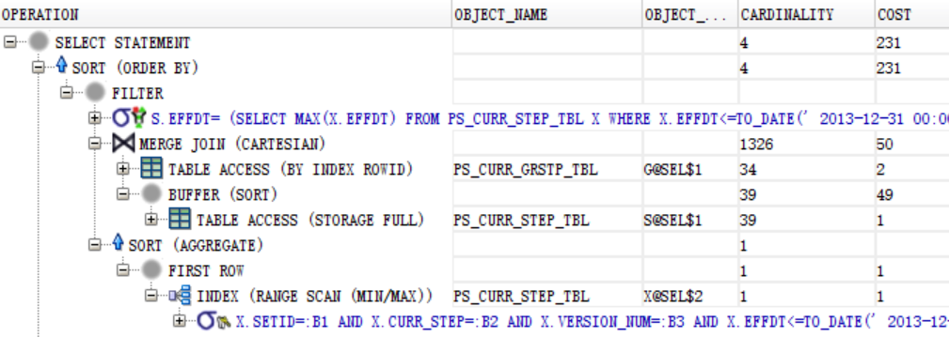
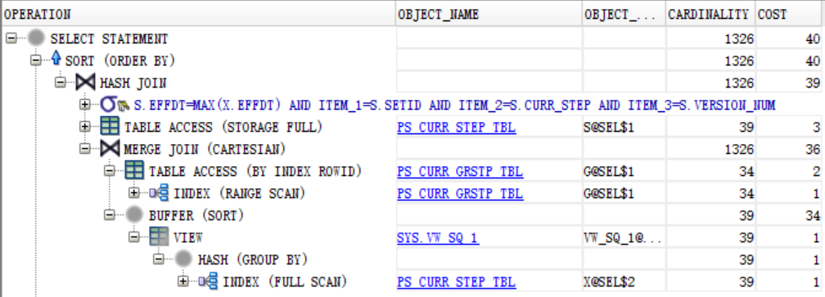
Subquery Unnesting - Peoplesoft SQL Case 1
Without subquery unnesting:
With subquery unnesting:

Slide 28
Subquery Unnesting - Peoplesoft SQL Case 1 - Performance
No subquery unnesting:
With subquery unnesting:
Note: SQL Work Area
Sort Area for sort/aggregate/.. operations
Hash Area for hash join, ..
Notes:
alter session set "_unnest_subquery"=false;
declare
ret number;
begin
for i in 1 .. 10000000
loop
SELECT
--/*+ unnest(@sel$2) */
count(*) into ret
FROM PS_CURR_GRSTP_TBL G , PS_CURR_STEP_TBL S
WHERE G.SETID = 'SHARE' AND S.EFFDT =
(SELECT MAX(X.EFFDT)
FROM PS_CURR_STEP_TBL X
WHERE X.SETID = S.SETID AND X.CURR_STEP = S.CURR_STEP AND X.VERSION_NUM = S.VERSION_NUM
AND X.EFFDT <= TO_DATE('2013-12-31','YYYY-MM-DD'))
AND S.EFF_STATUS = 'A' ORDER BY G.SEQUENCE_NBR_6;
end loop;
end;
/

Slide 29
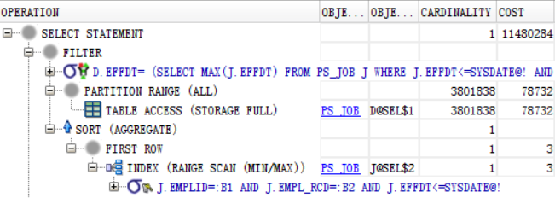
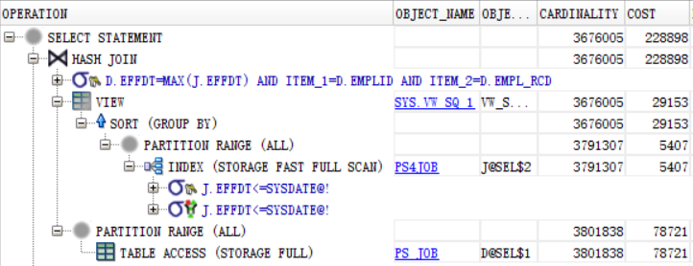
Subquery Unnesting - Peoplesoft SQL Case 2
SELECT * FROM PS_JOB D WHERE D.EFFDT = (SELECT MAX (J.EFFDT) FROM PS_JOB J WHERE J.EMPLID = D.EMPLID AND J.EMPL_RCD = D.EMPL_RCD AND J.EFFDT <= sysdate); | SELECT /*+ unnest(@sel$2) */ * FROM PS_JOB D WHERE D.EFFDT = (SELECT MAX (J.EFFDT) FROM PS_JOB J WHERE J.EMPLID = D.EMPLID AND J.EMPL_RCD = D.EMPL_RCD AND J.EFFDT <= sysdate);
Note: alter session set "_unnest_subquery"=false;
Notes:
Ref: BUG 14110304 - BAD CARDINALITY FROM SELF-JOIN W/ SINGLE-ROW SUBQUERY

Slide 30
Tip: Subquery unnesting disabled in PSFT DB
The following style of subquery ( without unnesting ) has been proved workable in production environment especially in complex SQL of PSFT HCM App.
select … from … where … and a.effdt = (select max(b.effdt) from b …)
When using correlated subquery, don’t expect optimizer will unnest it for you in PSFT DB. Especially be careful if:
Not like: where … and a.effdt = (select max(b.effdt) from b …)
The outer query will return large set of data.
Control Subquery Unnesting:
DB/Session Level: _unnest_subquery
PSFT Highly Recommanded Value: false
Sql Level: Hint UNNEST/NO_UNNEST
Select /*+ unnest(@qb_name) */ …

Slide 31
In and Exists Subquery
In and Exists subquery will be converted to join style no matter the value of _unnest_subquery
Controlled by:
_always_semi_join = choose / off / hash / nested_loops / …
Notes:
Ref: https://docs.oracle.com/database/121/TGSQL/tgsql_join.htm#TGSQL95241
The optimizer may choose a semijoin in the following circumstances:
The statement uses either an IN or EXISTS clause.
The statement contains a subquery in the IN or EXISTS clause.
The IN or EXISTS clause is not contained inside an OR branch.
Ref:
http://oracle-performance-tuning-tips3-dass.blogspot.jp/2012/03/hash-semi-join-oracle-tuning-tip26.html
https://explainextended.com/2009/09/30/in-vs-join-vs-exists-oracle/

Slide 32
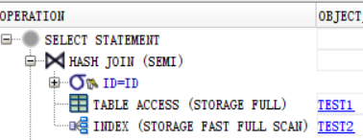
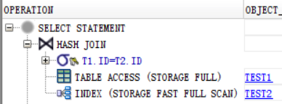
In / Exists subquery
Sometimes, both in and exists style use same execution plans (v12.1).
 | create index test2 on test2(id); | create unique index test2 on test2(id);
select * from test1 t1 where id in (select id from test2 t2); select * from test1 t1 where exists (select 1 from test2 t2 where t1.id=t2.id);
Notes:
Demo:
drop table test1;
create table test1 (id number,name varchar2(30));
insert into test1 select rownum,'name'||rownum from dual connect by level <=100000;
drop index test1;
create unique index test1 on test1(id);
drop table test2;
create table test2 (id number,name varchar2(30));
insert into test2 select rownum,'name'||rownum from dual connect by level <=1000000;
drop index test2;
--create index test2 on test2(id);
create unique index test2 on test2(id); -- with unique scan: hash join semi -> hash join
--alter session set "_always_semi_join"=choose;
select
*
from test1 t1
where id in (select id from test2);
select *
from test2 t2
where id in (select id from test1 t1);
select *
from test1 t1
where exists (select 1 from test2 t2 where t1.id=t2.id);
select
*
from test1 t1,test2 t2
where t1.id=t2.id;

Slide 33
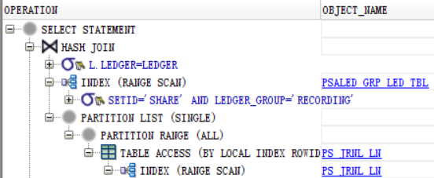
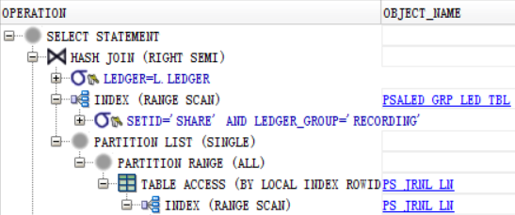
In / Exists subquery
Sometimes, they don’t(v12.1).
SELECT * FROM ps_jrnl_ln l WHERE … AND l.ledger IN ( SELECT ledger FROM ps_led_grp_led_tbl t WHERE setid ='SHARE' AND ledger_group = 'RECORDING' ); | SELECT * FROM ps_jrnl_ln l WHERE … AND exists ( SELECT ledger FROM ps_led_grp_led_tbl t WHERE setid ='SHARE' AND ledger_group = 'RECORDING' and ledger=l.ledger );
Notes:
SELECT * FROM ps_jrnl_ln l
WHERE l.business_unit ='X6001' AND l.journal_id >= 'XIU0100001' AND l.journal_id <= 'XIU0100010'
AND l.ledger IN (
SELECT
ledger FROM ps_led_grp_led_tbl t
WHERE setid ='SHARE'
AND ledger_group in( 'RECORDING') );
SELECT * FROM ps_jrnl_ln l
WHERE l.business_unit ='X6001' AND l.journal_id >= 'XIU0100001' AND l.journal_id <= 'XIU0100010'
AND exists (
SELECT ledger FROM ps_led_grp_led_tbl t WHERE setid ='SHARE'
AND ledger_group in ('RECORDING')
and ledger=l.ledger
);

Slide 34
Tip: In and Exists Subquery are similar now
They might still have some difference inside. But not that much now (v12.1)
Don’t judge too quick when you see IN style SQL. Check SQL plan always.

Slide 35
Overview of SQL Processing
Parsing
Optimization
Query Transformation
Estimation
Generating Execution Plan
Execution
Notes:
Ref: http://docs.oracle.com/database/121/TGSQL/tgsql_sqlproc.htm#TGSQL176

Slide 36
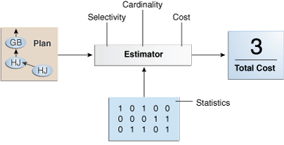
Optimizer Components - Estimator
The estimator is the component of the optimizer that determines the overall cost of a given execution plan.
The estimator uses three different measures
Selectivity
Tip: More distinct values, better candidate for indexing
Cardinality
Tip: Accurate Statistics, better execution plan
Tip: Gather Statistics on PS Temp Table Before Important SQL
Cost
Notes:
Ref: http://docs.oracle.com/database/121/TGSQL/tgsql_optcncpt.htm#TGSQL213

Slide 37
Optimizer Components - Estimator - Selectivity
A predicate filters a specific number of rows from a row set. Thus, the selectivity of a predicate indicates how many rows pass the predicate test.
Sample:
In this case, index Selectivity = 1/ Number of Distinct Values
Index Selectivity of TEST_ID1: 0.001
Index Selectivity of TEST_ID2: 0.002
create table test as select rownum id1, mod(rownum,500) id2 from all_tables where rownum<=1000; create index test_id1 on test(id1); create index test_id2 on test(id2); select * from test where id1=23 and id2=23; -------------------------------------------------------+-----------------------------------+ | Id | Operation | Name | Rows | Bytes | Cost | Time | -------------------------------------------------------+-----------------------------------+ | 0 | SELECT STATEMENT | | | | 2 | | | 1 | TABLE ACCESS BY INDEX ROWID BATCHED | TEST | 1 | 8 | 2 | 00:00:01 | | 2 | INDEX RANGE SCAN | TEST_ID1| 1 | | 1 | 00:00:01 | -------------------------------------------------------+-----------------------------------+
Notes:
A predicate filters a specific number of rows from a row set. Thus, the selectivity of a predicate indicates how many rows pass the predicate test. Selectivity ranges from 0.0 to 1.0. A selectivity of 0.0 means that no rows are selected from a row set, whereas a selectivity of 1.0 means that all rows are selected. A predicate becomes more selective as the value approaches 0.0 and less selective (or more unselective) as the value approaches 1.0.
Ref:
http://docs.oracle.com/database/121/TGSQL/tgsql_optcncpt.htm#TGSQL213
https://mosemp.us.oracle.com/epmos/faces/DocumentDisplay?_afrLoop=350956284978734&id=43041.1&displayIndex=9&_afrWindowMode=0&_adf.ctrl-state=3x6caypd5_175
https://mosemp.us.oracle.com/epmos/faces/DocumentDisplay?_afrLoop=426019615720187&id=887073.1&displayIndex=1&_afrWindowMode=0&_adf.ctrl-state=ycihjypb8_239

Slide 38
Tip: More distinct values, better candidate for indexing
Case 1
In this case, if can only choose one column, which one is the best candidate for indexing?
Case 2
In this case, is Account_Balance a good candidate for indexing?
Select count(*) From All_China_Population_Info Where Gender = ‘male’ And Birth_Date = <1999-09-09> And Native_Place = <Beijing>
Select count(*) From All_Mobile_Phone_Account_Info Where Account_Balance < 10
Notes:
In case 1, if can only choose one column, then Native_Place should be the best one for indexing. Because the selectivity of column Native_Place is comparatively better than other 2 columns.
In case 2, It depends. But I intend to not to index this column. Because the column value may be changed very frequently. This is another factor should be considered when choosing index columns.

Slide 39
Tip: More distinct values, better candidate for indexing (cont’d.)
Case 3
For above query, if we want to create a 2-columns index with column Name and Gender. Which one as follows is better?
Index 1: <Name, Gender>
Index 2: <Gender, Name>
Select id From ALL_CHINA_POPULATION_INFO Where Name=‘xxx’ And Gender='M‘;
Notes:
For query “… where name=xxx and gender=‘M’”. Both indexes are same. But index <Name, Gender> can also better support query “… where name=xxx”.
---------------------------------------------------------------
drop table All_China_Population_Info;
create table All_China_Population_Info (id number, name varchar2(3), gender varchar2(1), birth_date date, native_place varchar2(10), mobile_phone number);
insert into All_China_Population_Info
with s as (select level id from dual connect by level <=1000000)
select id,
dbms_random.string('l',3),
case when mod(id,2)=0 then 'F' else 'M' end,
sysdate-mod(id,365*100),
mod(id,31),
1e10+id
from s;
create index idx_name_gender on All_China_Population_Info(name,gender);
create index idx_gender_name on All_China_Population_Info(gender,name);
create index idx_mobile_phone on All_China_Population_Info(mobile_phone);
exec dbms_stats.gather_table_stats(user,'ALL_CHINA_POPULATION_INFO');
declare
v_id number;
begin
for i in 1..1000000 loop
select
--/*+ index(t idx_name_gender) */
/*+ index(t idx_gender_name) */
id into v_id from ALL_CHINA_POPULATION_INFO t where t.name=dbms_random.string('l',3) and gender='M' and rownum<2 ;
end loop;
end;
/

Slide 40
In some cases optimizer will not use index
Wrong type / Implicit type convert
Select * from ps_jrnl_ln where account=69200000; -- accout: varchar2(10)
Column in expression
Select * from ps_jrnl_ln where upper(business_unit)= ‘X6000’;
Wildcard in the head of search condition string
Select * from ps_jrnl_ln l where journal_id like '%0001';
Return large part of data (Optimizer need to aware the data distribution)
Select * from ps_jrnl_header where journal_date > to_date('19990104','yyyymmdd');
…

Slide 41
Optimizer Components - Estimator
The estimator is the component of the optimizer that determines the overall cost of a given execution plan.
The estimator uses three different measures
Selectivity
Tip: More distinct values, better candidate for indexing
Cardinality
Tip: Accurate Statistics, better execution plan
Tip: Gather Statistics on PS Temp Table Before Important SQL
Cost
Notes:
Ref: http://docs.oracle.com/database/121/TGSQL/tgsql_optcncpt.htm#TGSQL213

Slide 42
Optimizer Components - Estimator - Cardinality
The cardinality is the number of rows returned by each operation in an execution plan.
For example, if the optimizer estimate for the number of rows returned by a full table scan is 100, then the cardinality estimate for this operation is 100.
The cardinality estimate appears in the Rows column of the execution plan.
Cardinality estimates must be as accurate as possible because they influence all aspects of the execution plan. Cardinality is important when the optimizer determines the cost of a join.
For example, in a nested loops join of the employees and departments tables, the number of rows in employees determines how often the database must probe the departments table.
Cardinality is also important for determining the cost of sorts.

Slide 43
Case: Wrong Execution Plan caused by Wrong Cardinality
SELECT DISTINCT 'CC_APPROP', 6896239, … FROM PS_BP_ACT_TAO11 A, PS_LED_GRP_LED_TBL B, PS_BP_XCF_TAO1 CF1 , PS_BP_XCF_TAO1 CF2 , PS_BP_XCF_TAO1 CF3 , PS_BP_XCF_TAO1 CF4 , PS_BP_XLBP_TAO1 BP WHERE … AND A.PARENT_SUBTYPE = '1‘ AND A.PARENT_SUBTYPE = CF1.SUBTYPE AND CF1.CHARTFIELD ='PRODUCT' … AND A.PARENT_SUBTYPE = CF2.SUBTYPE AND CF2.CHARTFIELD ='FUND_CODE' …
Db: 12.1.0.2
optimizer_dynamic_sampling=0
optimizer_adaptive_features=FALSE
Notes:
Case: ps temp table , wrong statistics caused Cartesian join.
BUG 23721326 - FS_BP IS TAKING LONG TIME TO PROCESS 500 JOURNAL LINE
Db: 12.1.0.2
optimizer_dynamic_sampling=0
optimizer_adaptive_features=FALSE
The above settings caused the optimizer didn’t do the dynamic sampling for the temp table in the sql.
SELECT DISTINCT 'CC_APPROP', 6896239, KK_TRAN_LN, B.LEDGER, FISCAL_YEAR, ACCOUNTING_PERIOD, ' ', BUSINESS_UNIT, CF3.CHARTFIELD_VALUE, CF4.CHARTFIELD_VALUE, ' ', ' ', CF1.CHARTFIELD_VALUE, CF2.CHARTFIELD_VALUE, ' ', ' ', ' ', ' ', ' ', ' ', ' ', ' ', ' ', ' ', ' ', ' ', ' ', BP.BUDGET_PERIOD, A.PARENT_SUBTYPE
FROM PS_BP_ACT_TAO11 A, PS_LED_GRP_LED_TBL B, PS_BP_XCF_TAO1 CF1 , PS_BP_XCF_TAO1 CF2 , PS_BP_XCF_TAO1 CF3 , PS_BP_XCF_TAO1 CF4 , PS_BP_XLBP_TAO1 BP
WHERE
A.KK_TRAN_ID ='0026098474'
AND A.KK_TRAN_DT =TO_DATE('2016-07-01','YYYY-MM-DD')
AND B.LEDGER_GROUP ='CC_APPROP'
AND B.SETID ='STATE'
AND A.PROCESS_INSTANCE = 6896239
AND B.LEDGER_TYPE_KK ='0'
AND A.BALANCING_LINE = 'N'
AND A.PARENT_SUBTYPE = '1'
AND A.LEDGER_GROUP ='CC_ALLOT'
AND A.LEDGER_GROUP = CF1.KK_LEDGER_GROUP
AND A.PARENT_SUBTYPE = CF1.SUBTYPE
AND A.PROCESS_INSTANCE = CF1.PROCESS_INSTANCE
AND A.PRODUCT = CF1.CF_VALUE2
AND CF1.CHARTFIELD ='PRODUCT'
AND A.LEDGER_GROUP = CF2.KK_LEDGER_GROUP
AND A.PARENT_SUBTYPE = CF2.SUBTYPE
AND A.PROCESS_INSTANCE = CF2.PROCESS_INSTANCE
AND A.FUND_CODE = CF2.CF_VALUE2
AND CF2.CHARTFIELD ='FUND_CODE'
AND A.LEDGER_GROUP = CF3.KK_LEDGER_GROUP
AND A.PARENT_SUBTYPE = CF3.SUBTYPE
AND A.PROCESS_INSTANCE = CF3.PROCESS_INSTANCE
AND A.ACCOUNT = CF3.CF_VALUE2
AND CF3.CHARTFIELD ='ACCOUNT'
AND A.LEDGER_GROUP = CF4.KK_LEDGER_GROUP
AND A.PARENT_SUBTYPE = CF4.SUBTYPE
AND A.PROCESS_INSTANCE = CF4.PROCESS_INSTANCE
AND A.DEPTID = CF4.CF_VALUE2
AND CF4.CHARTFIELD ='DEPTID'
AND A.BUDGET_PERIOD = BP.BUDGET_PERIOD2
AND A.SUBTYPE = BP.SUBTYPE
AND A.PROCESS_INSTANCE = BP.PROCESS_INSTANCE
AND A.LEDGER_GROUP = BP.LEDGER_GROUP ;
Original Sql Text:
INSERT INTO PS_BP_PRNT_TAO11 (LEDGER_GROUP, PROCESS_INSTANCE, KK_TRAN_LN,
LEDGER, FISCAL_YEAR, ACCOUNTING_PERIOD, ERROR_FLAG, BUSINESS_UNIT, ACCOUNT,
DEPTID, STATISTICS_CODE, OPERATING_UNIT, PRODUCT, FUND_CODE, CLASS_FLD,
PROGRAM_CODE, BUDGET_REF, AFFILIATE, AFFILIATE_INTRA1, AFFILIATE_INTRA2,
CHARTFIELD1, CHARTFIELD2, CHARTFIELD3, BUSINESS_UNIT_PC, PROJECT_ID,
ACTIVITY_ID, RESOURCE_TYPE, BUDGET_PERIOD, SUBTYPE) SELECT /*+ LEADING(A) */
DISTINCT 'CC_APPROP', 6896239, KK_TRAN_LN, B.LEDGER, FISCAL_YEAR,
ACCOUNTING_PERIOD, ' ', BUSINESS_UNIT, CF3.CHARTFIELD_VALUE,
CF4.CHARTFIELD_VALUE, ' ', ' ', CF1.CHARTFIELD_VALUE, CF2.CHARTFIELD_VALUE, '
', ' ', ' ', ' ', ' ', ' ', ' ', ' ', ' ', ' ', ' ', ' ', ' ',
BP.BUDGET_PERIOD, A.PARENT_SUBTYPE FROM PS_BP_ACT_TAO11 A, PS_LED_GRP_LED_TBL
B , PS_BP_XCF_TAO11 CF1 , PS_BP_XCF_TAO11 CF2 , PS_BP_XCF_TAO11 CF3 ,
PS_BP_XCF_TAO11 CF4 , PS_BP_XLBP_TAO11 BP WHERE A.KK_TRAN_ID='0026098474'
AND A.KK_TRAN_DT=TO_DATE('2016-07-01','YYYY-MM-DD') AND
B.LEDGER_GROUP='CC_APPROP' AND B.SETID='STATE' AND A.PROCESS_INSTANCE=
6896239 AND B.LEDGER_TYPE_KK='0' AND A.BALANCING_LINE = 'N' AND
A.PARENT_SUBTYPE= '1' AND A.LEDGER_GROUP='CC_ALLOT' AND A.LEDGER_GROUP =
CF1.KK_LEDGER_GROUP AND A.PARENT_SUBTYPE = CF1.SUBTYPE AND A.PROCESS_INSTANCE
= CF1.PROCESS_INSTANCE AND A.PRODUCT = CF1.CF_VALUE2 AND
CF1.CHARTFIELD='PRODUCT' AND A.LEDGER_GROUP = CF2.KK_LEDGER_GROUP AND
A.PARENT_SUBTYPE = CF2.SUBTYPE AND A.PROCESS_INSTANCE = CF2.PROCESS_INSTANCE
AND A.FUND_CODE = CF2.CF_VALUE2 AND CF2.CHARTFIELD='FUND_CODE' AND
A.LEDGER_GROUP = CF3.KK_LEDGER_GROUP AND A.PARENT_SUBTYPE = CF3.SUBTYPE AND
A.PROCESS_INSTANCE = CF3.PROCESS_INSTANCE AND A.ACCOUNT = CF3.CF_VALUE2 AND
CF3.CHARTFIELD='ACCOUNT' AND A.LEDGER_GROUP = CF4.KK_LEDGER_GROUP AND
A.PARENT_SUBTYPE = CF4.SUBTYPE AND A.PROCESS_INSTANCE = CF4.PROCESS_INSTANCE
AND A.DEPTID = CF4.CF_VALUE2 AND CF4.CHARTFIELD='DEPTID' AND A.BUDGET_PERIOD
= BP.BUDGET_PERIOD2 AND A.SUBTYPE = BP.SUBTYPE AND A.PROCESS_INSTANCE =
BP.PROCESS_INSTANCE AND A.LEDGER_GROUP= BP.LEDGER_GROUP

Slide 44
Wrong Execution Plan ( elapsed time: 12hours+)
| Id | Operation | Name | Rows | Bytes | Cost (%CPU) ------------------------------------------------------------------------------------------------------ | 0 | SELECT STATEMENT | | 1 | 1250 | 4 (25) | 1 | HASH UNIQUE | | 1 | 1250 | 4 (25) | 2 | NESTED LOOPS | | 1 | 1250 | 3 (0) | 3 | NESTED LOOPS | | 1 | 1250 | 3 (0) | 4 | MERGE JOIN CARTESIAN | | 1 | 997 | 3 (0) | 5 | MERGE JOIN CARTESIAN | | 1 | 969 | 2 (0) | 6 | MERGE JOIN CARTESIAN | | 1 | 876 | 0 (0) | 7 | MERGE JOIN CARTESIAN | | 1 | 657 | 0 (0) | 8 | MERGE JOIN CARTESIAN | | 1 | 438 | 0 (0) |* 9 | TABLE ACCESS BY INDEX ROWID | PS_BP_XCF_TAO1 | 1 | 219 | 0 (0) |* 10 | INDEX RANGE SCAN | PSABP_XCF_TAO1 | 1 | | 0 (0) | 11 | BUFFER SORT | | 1 | 219 | 0 (0) |* 12 | TABLE ACCESS BY INDEX ROWID BATCHED| PS_BP_XCF_TAO1 | 1 | 219 | 0 (0) |* 13 | INDEX RANGE SCAN | PSABP_XCF_TAO1 | 1 | | 0 (0) | 14 | BUFFER SORT | | 1 | 219 | 0 (0) |* 15 | TABLE ACCESS BY INDEX ROWID BATCHED | PS_BP_XCF_TAO1 | 1 | 219 | 0 (0) |* 16 | INDEX RANGE SCAN | PSABP_XCF_TAO1 | 1 | | 0 (0) | 17 | BUFFER SORT | | 1 | 219 | 0 (0) |* 18 | TABLE ACCESS BY INDEX ROWID BATCHED | PS_BP_XCF_TAO1 | 1 | 219 | 0 (0) |* 19 | INDEX RANGE SCAN | PSABP_XCF_TAO1 | 1 | | 0 (0) …
Notes:
Card of Cartesian: Cf1*cf2*cf3*cf4 * B =142*102*377*50 * B =273,023,400 * B
Nested Loop Count: Card of Cartesian * A * A = 273,023,400 * B * 150 * 150 = 6,143,026,500,000 * B
No Hints:
-------------------------------------------------------------------------------------------------------------------
| Id | Operation | Name | Rows | Bytes | Cost (%CPU)| Time |
-------------------------------------------------------------------------------------------------------------------
| 0 | SELECT STATEMENT | | 1 | 1250 | 4 (25)| 00:00:01 |
| 1 | HASH UNIQUE | | 1 | 1250 | 4 (25)| 00:00:01 |
| 2 | NESTED LOOPS | | 1 | 1250 | 3 (0)| 00:00:01 |
| 3 | NESTED LOOPS | | 1 | 1250 | 3 (0)| 00:00:01 |
| 4 | MERGE JOIN CARTESIAN | | 1 | 997 | 3 (0)| 00:00:01 |
| 5 | MERGE JOIN CARTESIAN | | 1 | 969 | 2 (0)| 00:00:01 |
| 6 | MERGE JOIN CARTESIAN | | 1 | 876 | 0 (0)| 00:00:01 |
| 7 | MERGE JOIN CARTESIAN | | 1 | 657 | 0 (0)| 00:00:01 |
| 8 | MERGE JOIN CARTESIAN | | 1 | 438 | 0 (0)| 00:00:01 |
|* 9 | TABLE ACCESS BY INDEX ROWID | PS_BP_XCF_TAO1 | 1 | 219 | 0 (0)| 00:00:01 |
|* 10 | INDEX RANGE SCAN | PSABP_XCF_TAO1 | 1 | | 0 (0)| 00:00:01 |
| 11 | BUFFER SORT | | 1 | 219 | 0 (0)| 00:00:01 |
|* 12 | TABLE ACCESS BY INDEX ROWID BATCHED| PS_BP_XCF_TAO1 | 1 | 219 | 0 (0)| 00:00:01 |
|* 13 | INDEX RANGE SCAN | PSABP_XCF_TAO1 | 1 | | 0 (0)| 00:00:01 |
| 14 | BUFFER SORT | | 1 | 219 | 0 (0)| 00:00:01 |
|* 15 | TABLE ACCESS BY INDEX ROWID BATCHED | PS_BP_XCF_TAO1 | 1 | 219 | 0 (0)| 00:00:01 |
|* 16 | INDEX RANGE SCAN | PSABP_XCF_TAO1 | 1 | | 0 (0)| 00:00:01 |
| 17 | BUFFER SORT | | 1 | 219 | 0 (0)| 00:00:01 |
|* 18 | TABLE ACCESS BY INDEX ROWID BATCHED | PS_BP_XCF_TAO1 | 1 | 219 | 0 (0)| 00:00:01 |
|* 19 | INDEX RANGE SCAN | PSABP_XCF_TAO1 | 1 | | 0 (0)| 00:00:01 |
| 20 | BUFFER SORT | | 1 | 93 | 2 (0)| 00:00:01 |
|* 21 | TABLE ACCESS STORAGE FULL | PS_BP_XLBP_TAO1 | 1 | 93 | 2 (0)| 00:00:01 |
| 22 | BUFFER SORT | | 5 | 140 | 1 (0)| 00:00:01 |
|* 23 | INDEX RANGE SCAN | PSALED_GRP_LED_TBL | 5 | 140 | 1 (0)| 00:00:01 |
|* 24 | INDEX RANGE SCAN | PSABP_ACT_TAO11 | 1 | | 0 (0)| 00:00:01 |
|* 25 | TABLE ACCESS BY INDEX ROWID | PS_BP_ACT_TAO11 | 1 | 253 | 0 (0)| 00:00:01 |
-------------------------------------------------------------------------------------------------------------------
9 - filter("CF1"."PROCESS_INSTANCE"=6896239 AND "CF1"."KK_LEDGER_GROUP"='CC_ALLOT')
10 - access("CF1"."CHARTFIELD"='PRODUCT' AND "CF1"."SUBTYPE"='1')
12 - filter("CF2"."PROCESS_INSTANCE"=6896239 AND "CF2"."KK_LEDGER_GROUP"='CC_ALLOT')
13 - access("CF2"."CHARTFIELD"='FUND_CODE' AND "CF2"."SUBTYPE"='1')
15 - filter("CF3"."PROCESS_INSTANCE"=6896239 AND "CF3"."KK_LEDGER_GROUP"='CC_ALLOT')
16 - access("CF3"."CHARTFIELD"='ACCOUNT' AND "CF3"."SUBTYPE"='1')
18 - filter("CF4"."PROCESS_INSTANCE"=6896239 AND "CF4"."KK_LEDGER_GROUP"='CC_ALLOT')
19 - access("CF4"."CHARTFIELD"='DEPTID' AND "CF4"."SUBTYPE"='1')
21 - storage("BP"."PROCESS_INSTANCE"=6896239 AND "BP"."LEDGER_GROUP"='CC_ALLOT')
filter("BP"."PROCESS_INSTANCE"=6896239 AND "BP"."LEDGER_GROUP"='CC_ALLOT')
23 - access("B"."SETID"='STATE' AND "B"."LEDGER_GROUP"='CC_APPROP' AND "B"."LEDGER_TYPE_KK"='0')
24 - access("A"."PROCESS_INSTANCE"=6896239 AND "A"."KK_TRAN_ID"='0026098474' AND
"A"."KK_TRAN_DT"=TO_DATE(' 2016-07-01 00:00:00', 'syyyy-mm-dd hh24:mi:ss') AND
"A"."LEDGER_GROUP"='CC_ALLOT')
filter("A"."LEDGER_GROUP"='CC_ALLOT')
25 - filter("A"."PRODUCT"="CF1"."CF_VALUE2" AND "A"."FUND_CODE"="CF2"."CF_VALUE2" AND
"A"."ACCOUNT"="CF3"."CF_VALUE2" AND "A"."DEPTID"="CF4"."CF_VALUE2" AND
"A"."BUDGET_PERIOD"="BP"."BUDGET_PERIOD2" AND "A"."SUBTYPE"="BP"."SUBTYPE" AND "A"."BALANCING_LINE"='N'
AND "A"."PARENT_SUBTYPE"='1')

Slide 45
Try with right cardinality
SELECT /*+ opt_estimate(table a rows=150) opt_estimate(table b rows=5) opt_estimate(table cf1 rows=142) opt_estimate(table cf2 rows=102) opt_estimate(table cf3 rows=377) opt_estimate(table cf4 rows=50) */ DISTINCT 'CC_APPROP', 6896239, … FROM PS_BP_ACT_TAO11 A, PS_LED_GRP_LED_TBL B, PS_BP_XCF_TAO1 CF1 , PS_BP_XCF_TAO1 CF2 , PS_BP_XCF_TAO1 CF3 , PS_BP_XCF_TAO1 CF4 , PS_BP_XLBP_TAO1 BP WHERE …

Slide 46
Right Execution Plan with hint( elapsed time: < 1 second)
| Id | Operation | Name | Rows | Bytes | Cost (%CPU) ---------------------------------------------------------------------------------------------- | 0 | SELECT STATEMENT | | 1 | 1250 | 4 (25) | 1 | HASH UNIQUE | | 1 | 1250 | 4 (25) | 2 | MERGE JOIN CARTESIAN | | 1 | 1250 | 3 (0) | 3 | NESTED LOOPS | | 1 | 1222 | 2 (0) | 4 | NESTED LOOPS | | 1 | 1222 | 2 (0) | 5 | NESTED LOOPS | | 1 | 1003 | 2 (0) | 6 | NESTED LOOPS | | 1 | 784 | 2 (0) | 7 | NESTED LOOPS | | 1 | 565 | 2 (0) | 8 | NESTED LOOPS | | 1 | 346 | 2 (0) |* 9 | TABLE ACCESS STORAGE FULL | PS_BP_XLBP_TAO1 | 1 | 93 | 2 (0) |* 10 | TABLE ACCESS BY INDEX ROWID| PS_BP_ACT_TAO11 | 1 | 253 | 0 (0) |* 11 | INDEX RANGE SCAN | PSABP_ACT_TAO11 | 1 | | 0 (0) |* 12 | TABLE ACCESS BY INDEX ROWID | PS_BP_XCF_TAO1 | 1 | 219 | 0 (0) |* 13 | INDEX RANGE SCAN | PSABP_XCF_TAO1 | 1 | | 0 (0) |* 14 | TABLE ACCESS BY INDEX ROWID | PS_BP_XCF_TAO1 | 1 | 219 | 0 (0) |* 15 | INDEX RANGE SCAN | PSABP_XCF_TAO1 | 1 | | 0 (0) |* 16 | TABLE ACCESS BY INDEX ROWID | PS_BP_XCF_TAO1 | 1 | 219 | 0 (0) |* 17 | INDEX RANGE SCAN | PSABP_XCF_TAO1 | 1 | | 0 (0) |* 18 | INDEX RANGE SCAN | PSABP_XCF_TAO1 | 1 | | 0 (0) |* 19 | TABLE ACCESS BY INDEX ROWID | PS_BP_XCF_TAO1 | 1 | 219 | 0 (0)
Notes:
With cardinality hints:
/*+
opt_estimate(table a rows=150) opt_estimate(table b rows=5)
opt_estimate(table cf1 rows=142) opt_estimate(table cf2 rows=102) opt_estimate(table cf3 rows=377) opt_estimate(table cf4 rows=50)
--opt_estimate(table bp rows=1)
--opt_estimate(join(bp a) rows=200)
*/
----------------------------------------------------------------------------------------------------------
| Id | Operation | Name | Rows | Bytes | Cost (%CPU)| Time |
----------------------------------------------------------------------------------------------------------
| 0 | SELECT STATEMENT | | 1 | 1250 | 4 (25)| 00:00:01 |
| 1 | HASH UNIQUE | | 1 | 1250 | 4 (25)| 00:00:01 |
| 2 | MERGE JOIN CARTESIAN | | 1 | 1250 | 3 (0)| 00:00:01 |
| 3 | NESTED LOOPS | | 1 | 1222 | 2 (0)| 00:00:01 |
| 4 | NESTED LOOPS | | 1 | 1222 | 2 (0)| 00:00:01 |
| 5 | NESTED LOOPS | | 1 | 1003 | 2 (0)| 00:00:01 |
| 6 | NESTED LOOPS | | 1 | 784 | 2 (0)| 00:00:01 |
| 7 | NESTED LOOPS | | 1 | 565 | 2 (0)| 00:00:01 |
| 8 | NESTED LOOPS | | 1 | 346 | 2 (0)| 00:00:01 |
|* 9 | TABLE ACCESS STORAGE FULL | PS_BP_XLBP_TAO1 | 1 | 93 | 2 (0)| 00:00:01 |
|* 10 | TABLE ACCESS BY INDEX ROWID| PS_BP_ACT_TAO11 | 1 | 253 | 0 (0)| 00:00:01 |
|* 11 | INDEX RANGE SCAN | PSABP_ACT_TAO11 | 1 | | 0 (0)| 00:00:01 |
|* 12 | TABLE ACCESS BY INDEX ROWID | PS_BP_XCF_TAO1 | 1 | 219 | 0 (0)| 00:00:01 |
|* 13 | INDEX RANGE SCAN | PSABP_XCF_TAO1 | 1 | | 0 (0)| 00:00:01 |
|* 14 | TABLE ACCESS BY INDEX ROWID | PS_BP_XCF_TAO1 | 1 | 219 | 0 (0)| 00:00:01 |
|* 15 | INDEX RANGE SCAN | PSABP_XCF_TAO1 | 1 | | 0 (0)| 00:00:01 |
|* 16 | TABLE ACCESS BY INDEX ROWID | PS_BP_XCF_TAO1 | 1 | 219 | 0 (0)| 00:00:01 |
|* 17 | INDEX RANGE SCAN | PSABP_XCF_TAO1 | 1 | | 0 (0)| 00:00:01 |
|* 18 | INDEX RANGE SCAN | PSABP_XCF_TAO1 | 1 | | 0 (0)| 00:00:01 |
|* 19 | TABLE ACCESS BY INDEX ROWID | PS_BP_XCF_TAO1 | 1 | 219 | 0 (0)| 00:00:01 |
| 20 | BUFFER SORT | | 5 | 140 | 3 (0)| 00:00:01 |
|* 21 | INDEX RANGE SCAN | PSALED_GRP_LED_TBL | 5 | 140 | 1 (0)| 00:00:01 |
----------------------------------------------------------------------------------------------------------
9 - storage("BP"."PROCESS_INSTANCE"=6896239 AND "BP"."LEDGER_GROUP"='CC_ALLOT')
filter("BP"."PROCESS_INSTANCE"=6896239 AND "BP"."LEDGER_GROUP"='CC_ALLOT')
10 - filter("A"."BUDGET_PERIOD"="BP"."BUDGET_PERIOD2" AND "A"."SUBTYPE"="BP"."SUBTYPE" AND
"A"."BALANCING_LINE"='N' AND "A"."PARENT_SUBTYPE"='1')
11 - access("A"."PROCESS_INSTANCE"=6896239 AND "A"."KK_TRAN_ID"='0026098474' AND
"A"."KK_TRAN_DT"=TO_DATE(' 2016-07-01 00:00:00', 'syyyy-mm-dd hh24:mi:ss') AND
"A"."LEDGER_GROUP"='CC_ALLOT')
filter("A"."LEDGER_GROUP"='CC_ALLOT')
12 - filter("CF4"."PROCESS_INSTANCE"=6896239 AND "CF4"."KK_LEDGER_GROUP"='CC_ALLOT')
13 - access("CF4"."CHARTFIELD"='DEPTID' AND "CF4"."SUBTYPE"='1' AND
"A"."DEPTID"="CF4"."CF_VALUE2")
filter("A"."DEPTID"="CF4"."CF_VALUE2")
14 - filter("CF2"."PROCESS_INSTANCE"=6896239 AND "CF2"."KK_LEDGER_GROUP"='CC_ALLOT')
15 - access("CF2"."CHARTFIELD"='FUND_CODE' AND "CF2"."SUBTYPE"='1' AND
"A"."FUND_CODE"="CF2"."CF_VALUE2")
filter("A"."FUND_CODE"="CF2"."CF_VALUE2")
16 - filter("CF1"."PROCESS_INSTANCE"=6896239 AND "CF1"."KK_LEDGER_GROUP"='CC_ALLOT')
17 - access("CF1"."CHARTFIELD"='PRODUCT' AND "CF1"."SUBTYPE"='1' AND
"A"."PRODUCT"="CF1"."CF_VALUE2")
filter("A"."PRODUCT"="CF1"."CF_VALUE2")
18 - access("CF3"."CHARTFIELD"='ACCOUNT' AND "CF3"."SUBTYPE"='1' AND
"A"."ACCOUNT"="CF3"."CF_VALUE2")
filter("A"."ACCOUNT"="CF3"."CF_VALUE2")
19 - filter("CF3"."PROCESS_INSTANCE"=6896239 AND "CF3"."KK_LEDGER_GROUP"='CC_ALLOT')
21 - access("B"."SETID"='STATE' AND "B"."LEDGER_GROUP"='CC_APPROP' AND "B"."LEDGER_TYPE_KK"='0')
Ref:
Opt_estimate: https://www.pythian.com/blog/oracles-opt_estimate-hint-usage-guide/

Slide 47
Tip: Accurate Statistics, better execution plan
In most of cases, the optimizer can find the right execution plan if we let it have the right cardinality.
OPT_ESTIMATE can be helpful when analyzing execution plan issue.

Slide 48
Optimizer Statistics
Statistics are critical to the optimizer's ability to pick the best execution plan for a SQL statement.
Selectivity / Cardinality / Cost
Optimizer statistics include the following:
Table statistics:
Number of rows / Number of blocks / Average row length
Column statistics :
Number of distinct values (NDV) in a column / Number of nulls in a column / Data distribution (histogram) / Extended statistics
Index statistics :
Number of leaf blocks / Number of levels / Index clustering factor
System statistics :
I/O performance and utilization / CPU performance and utilization
Notes:
Ref: http://docs.oracle.com/database/121/TGSQL/tgsql_statscon.htm#TGSQL336

Slide 49
Optimizer Statistics – Check and Gather Table Statistics
The quick and intuitive indicator to show if the statistics stale
select table_name,last_analyzed,num_rows from user_tables;
Gather Table Statistics:
Exec dbms_stats.gather_table_stats(‘EMDBO’,’PS_JRNL_LN’, method_opt=>’for all columns size 254’, degree=>8, no_invalidate => false);
Dynamic Sampling
Default level = 2
If at least one table in the statement has no statistics, dynamic statistics automatically run recursive SQL during parsing to scan a small random sample of table blocks.
Notes:
Ref:
http://docs.oracle.com/database/121/TGSQL/tgsql_astat.htm#TGSQL450
select table_name,last_analyzed,num_rows
from user_tables
where table_name like 'PS_JRNL_%' and num_rows is not null
order by num_rows desc
fetch first 10 rows only;
TABLE_NAME LAST_ANALYZED NUM_ROWS
-------------------- ------------- ----------
PS_JRNL_LN 18-MAY-16 2444162494
PS_JRNL_HEADER 23-MAR-16 560855
PS_JRNL_CF_BAL_TBL 02-MAR-16 2062
PS_JRNLGEN_DEFNV 05-FEB-16 419
PS_JRNL_EDIT_REQ 31-MAR-16 373
PS_JRNL_VAT 02-MAR-16 309
PS_JRNLGEN_DEFMB 05-FEB-16 85
PS_JRNLGEN_REQUEST 05-FEB-16 78
PS_JRNLGEN_APPL_ID 05-FEB-16 59
PS_JRNL_AF_XREF 05-FEB-16 54

Slide 50
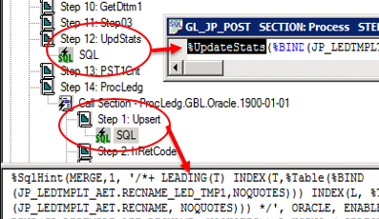
Tip: Gather Statistics on PS Temp Table Before Important SQL
PeopleTools Meta-SQL: %UpdateStats
Can be disabled by:
DbFlags=1
DisableGTTStats=1 (Def: 0, for GTT only)
Can’t run %UpdateStats (in a loop action of a restartable pgm?):
Set optimizer_dynamic_sampling=2 (default)
Add dynamic sampling hint into SQL:
SELECT /*+ DYNAMIC_SAMPLING(t 2) */ … from t
Delete & Lock table statistics firstly.
Note: 1. If table t has stats, then dynamic sampling may not kick in.
2. Dynamic Sampling doesn’t commit/rollback the current uncommitted transaction.
3. Dynamic Sampling Statistics is statement level. Same statement will reuse the statistics. And can’t be shared to other statements.
Notes:
Demo:
-- dynamic sampling test
alter session set optimizer_dynamic_sampling=0;
drop table test;
create table test(id number);
insert into test select rownum from DUAL CONNECT BY LEVEL <=1000;
commit;
select count(*) from test;
--1000
select * from test t; -- 82
select /*+ DYNAMIC_SAMPLING(t 2) */ * from test t; --1000, dyn sam will kick in because of no tab stats
exec dbms_stats.gather_table_stats(USER,'TEST');
select dbms_transaction.local_transaction_id from dual;
insert into test select rownum from DUAL CONNECT BY LEVEL <=100000;
commit;
select count(*) from test;
--101000
select * from test t; --1000
select /*+ DYNAMIC_SAMPLING(t 2) */ * from test t; --1000, dyn sam may not kick in if tab has stats.
%UpdateStats:
Ref: http://docs.oracle.com/cd/E66686_01/pt855pbr0/eng/pt/tape/langref_UsingApplicationEngineMeta-SQL-0771d9.html
Oracle uses DDL templates (in PSDDLMODEL) to determine SQL statements for %UpdateStats. Use DDLORA.DMS to change.
Specifying LOW produces the statement
execute DBMS_STATS.GATHER_TABLE_STATS (ownname=> 'PT8468908', tabname=>'PSSTATUS', estimate_percent=>20, method_opt=> 'FOR ALL INDEXED COLUMNS SIZE 1',cascade=>TRUE)
Specifying HIGH produces the statement
execute DBMS_STATS.GATHER_TABLE_STATS (ownname=> 'PT848908', tabname=>'PSSTATUS', estimate_percent=> dbms_stats.auto_sample_size, method_opt=> 'FOR ALL INDEXED COLUMNS SIZE 1',cascade=>TRUE)
DisableGTTStats:
Ref: BUG 21497281 - %UPDATESTATS IS IGNORED IF TABLE IS GLOBAL TEMPORARY TABLE
; DbFlags Bitfield
;
; Bit Flag
; --- ----
; 1 - Ignore metaSQL to update database statistics(shared with COBOL)
Dynamic sampling hint:
Ref: http://docs.oracle.com/database/121/SQLRF/sql_elements006.htm#BABDCGAA

Slide 51
Optimizer Components – Estimator - Cost
The optimizer cost model accounts for the I/O, CPU, and network resources that a query is predicted to use.
The cost is an numeric measure that represents the estimated resource usage for a plan. The lower the cost, the more efficient the plan.

Slide 52
Q&A?
Parsing
Tip: Use bind variable to avoid hard parse
Optimization
Query Transformation
View Merging
Tip: Optimizer can do View Merging for you
Subquery Unnesting
Tip: Subquery unnesting disabled in PSFT DB
Tip: In and Exists Subquery are similar now
Estimation
Selectivity: Tip: More distinct values, better candidate for indexing
Cardinality
Tip: Accurate Statistics, better execution plan
Tip: Gather Statistics on PS Temp Table Before Important SQL
Notes:
Ref: http://docs.oracle.com/database/121/TGSQL/tgsql_sqlproc.htm#TGSQL176

